Slide 1
Presentation topic: Stock Market Analysis
Group Members
Muhammad Talal 22018206
Muhammad Usman 22020952
Muhammad Awais 22027179

Slide 2
Introduction (1/2):
Stock Data of Alphabet Inc. (GOOG) is used for Stock Market Analysis.
Alphabet Inc. is a multinational technology conglomerate holding company headquartered in Mountain View, California.
Alphabet is considered one of the world's most valuable and influential companies, with a major focus on internet-related services and products.

Slide 3
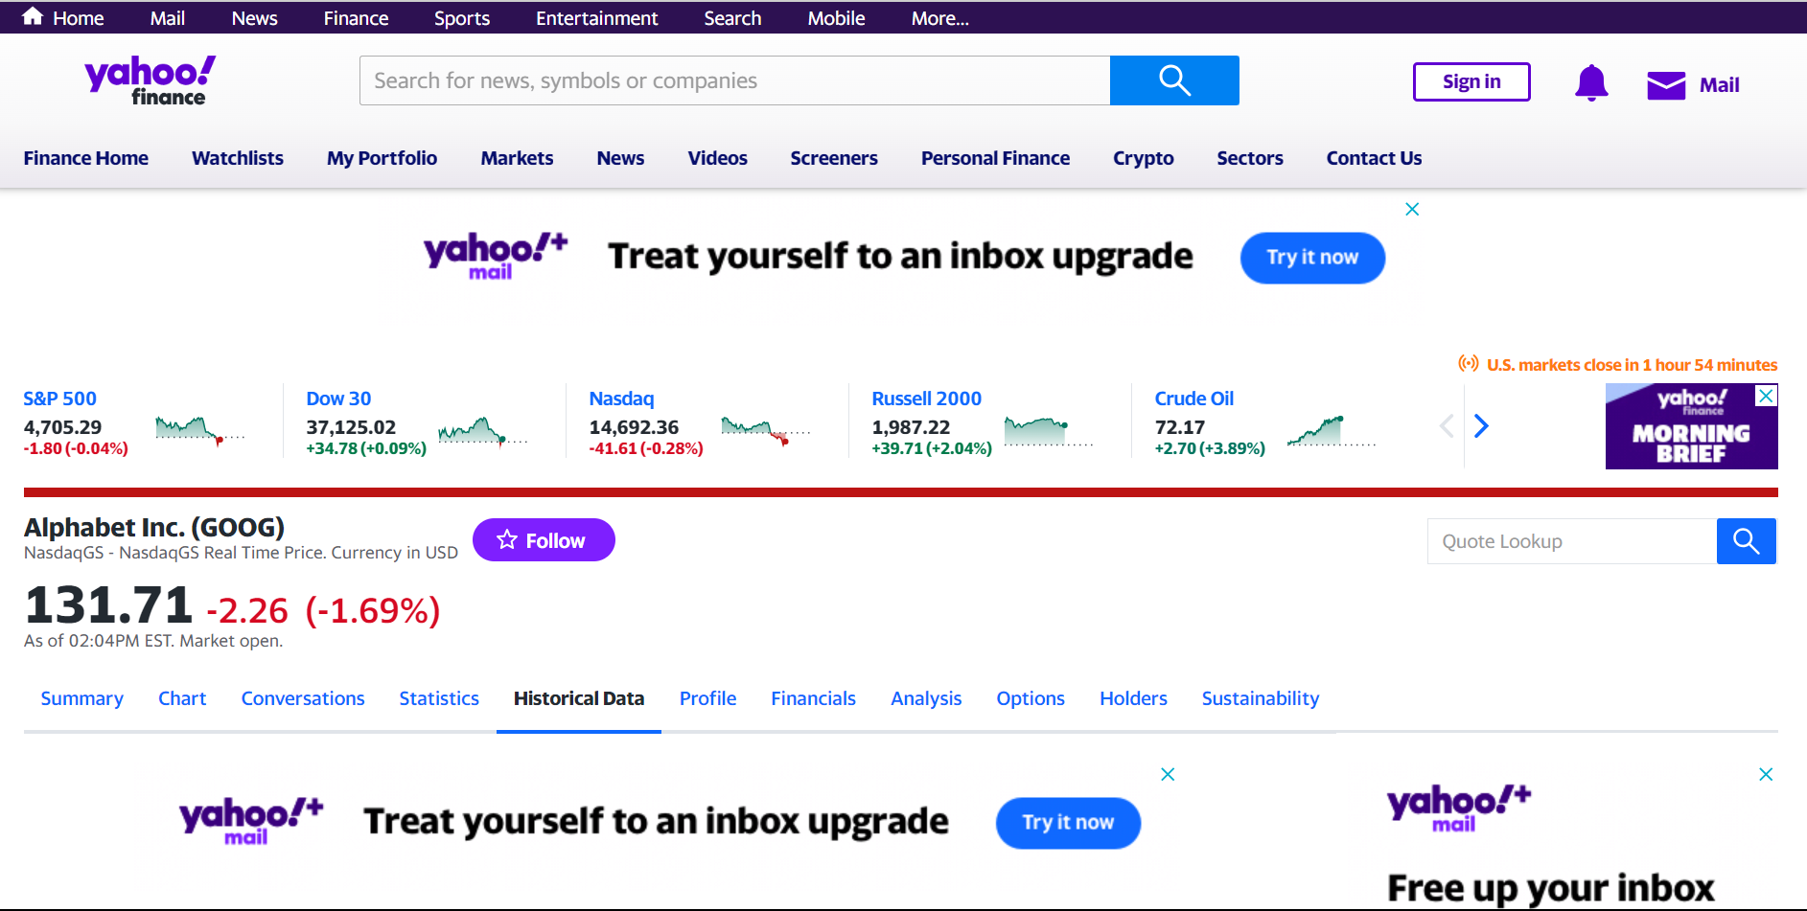
Introduction (2/2):

Slide 4
Dataset
Data is extracted from Yahoo Finance, and it covers:
Historical Prices (includes daily, weekly, or monthly closing prices, opening prices, highs, lows, and adjusted closing prices)
Volume Data (shows the number of shares traded on each day or period, indicating trading activity and investor sentiment)
Data span from 2004-01-01 to 2023-11-30
Data Fields consist of:
Date
Open
High
Low
Close
Volume

Slide 5
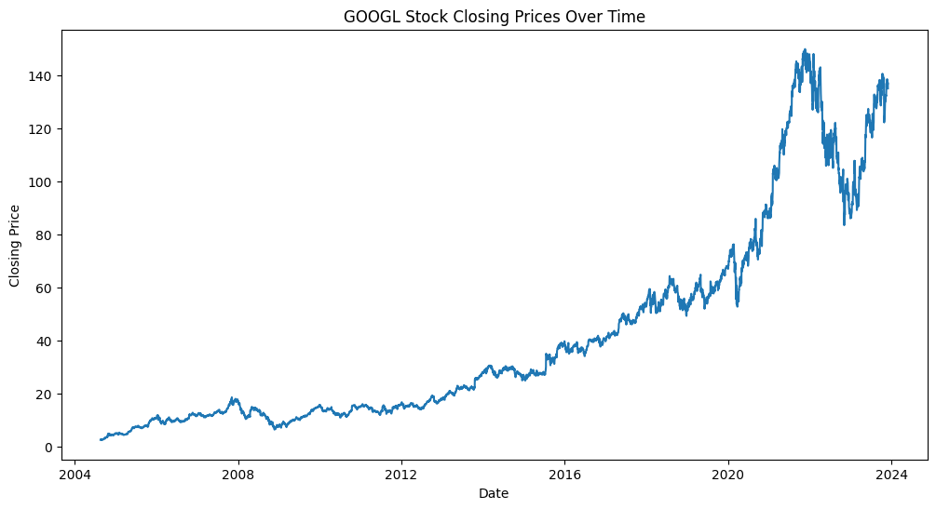
Exploratory Data Analysis (1/2)
The presented plot showcases the closing prices of Alphabet Inc. (GOOGL) stock over time, visualizing the fluctuation and trends in the company's financial performance.
The x-axis represents dates, while the y-axis denotes the corresponding closing prices, providing a concise overview of historical stock behavior.

Slide 6
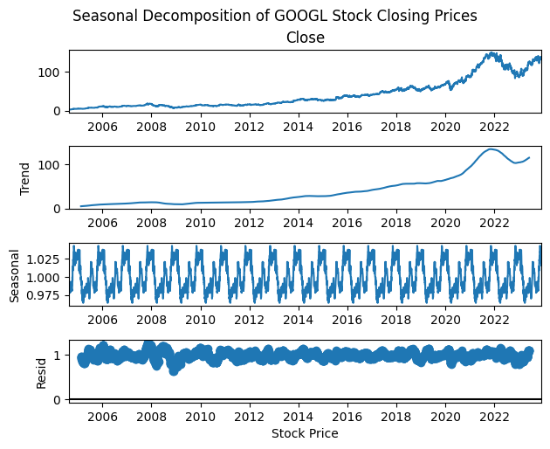
Exploratory Data Analysis (2/2)
The displayed seasonal decomposition illustrates the components trend, seasonality, and residual of Alphabet Inc. (GOOGL) stock closing prices.
Utilizing a multiplicative model and assuming daily data with a yearly period of 252 trading days, the plot provides insights into the underlying patterns influencing the stock's performance.

Slide 7
Data Preprocessing
Data Scaling using MinMaxScaler (range: 0-1)
Data Splitting (80% training, 20% testing)
Time-Series sequences: generates input-output sequences of length 10 for training and testing sets.

Slide 8
Model Training (1/3)
In this stock market prediction model, Long Short-Term Memory (LSTM) layers are utilized for capturing temporal dependencies in sequential data.
The model incorporates 4 LSTM layers, each with 50 neurons, to capture temporal patterns.
Additionally, 4 Dropout layers with a value of 0.1 each are included to mitigate overfitting.
A final Dense layer is employed for generating predictions based on the learned information from the LSTM layers.
The model is compiled using the Adam optimizer and Mean Squared Error loss function. Training is conducted with various epoch values (12, 25, 50, 100) to identify the optimal performance, utilizing a fixed batch size of 32.

Slide 9
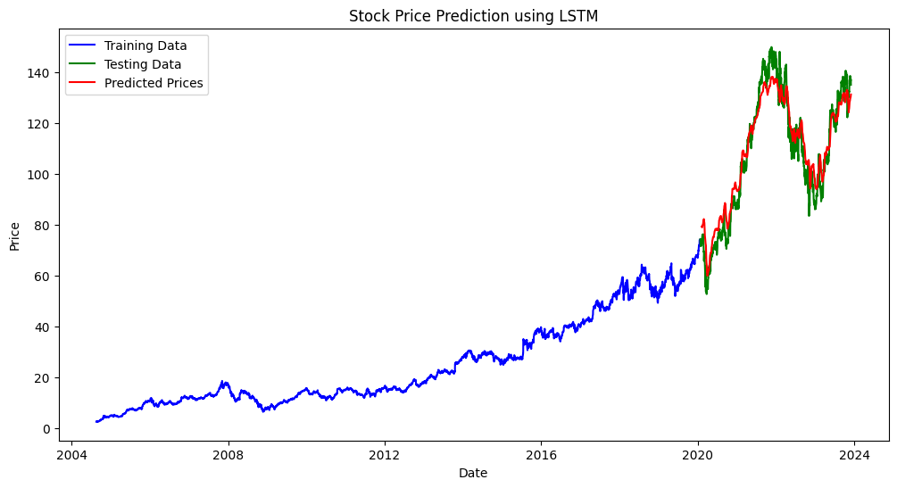
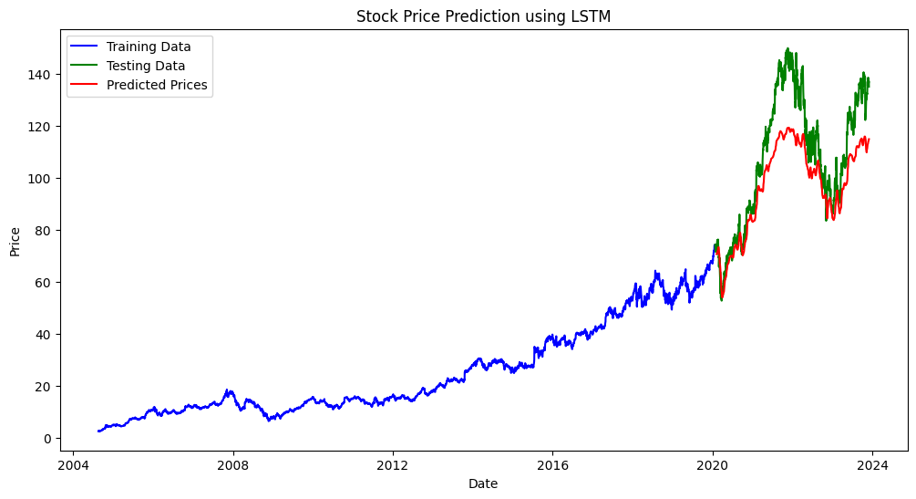
Model Training (2/3)
Epochs: 12
RMSE: 6.51
Epochs: 25
RMSE: 16251.55

Slide 10
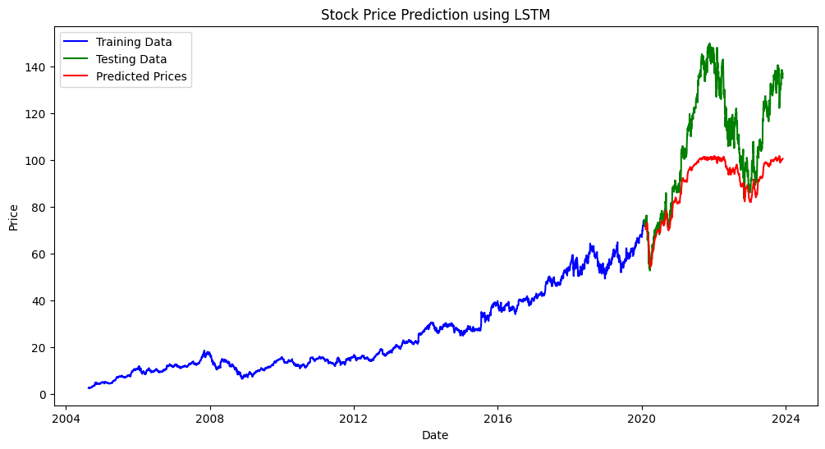
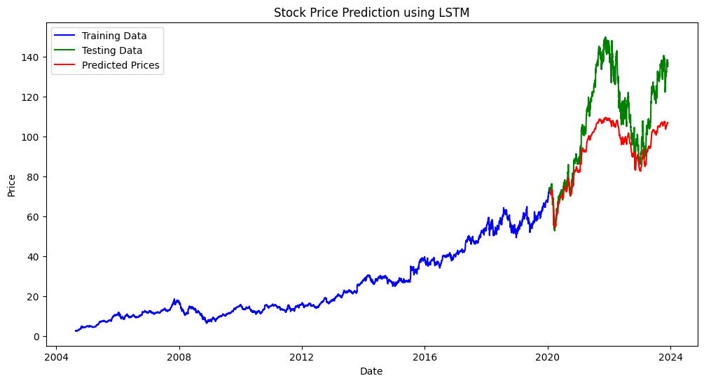
Model Training (3/3)
Epochs: 50
RMSE: 2408766.70
Epochs: 100
RMSE: 354910596.65

Slide 11
Conclusion
In this study, we leveraged historical stock data of Alphabet Inc. (GOOG) obtained from Yahoo Finance.
Preprocessing, including MinMax scaling and sequence creation, a Long Short-Term Memory (LSTM) model was trained for stock price prediction.
Among different epochs tested (12, 25, 50, 100), the model exhibited the best performance with 12 epochs, achieving a Root Mean Squared Error (RMSE) of 6.5, showcasing its effectiveness in capturing temporal dependencies for accurate stock market predictions.

Slide 12
References
Data (https://finance.yahoo.com/quote/GOOG?p=GOOG)
Moghar, A., & Hamiche, M. (2020). Stock market prediction using LSTM recurrent neural network. Procedia Computer Science, 170, 1168-1173.
Malim, T. N. A. B. T., Kamarudin, S. A., Ahad, N. A., & Mamat, N. A. M. G. (2022, November). Prediction of FTSE Bursa Malaysia KLCI Stock Market using LSTM Recurrent Neural Network. In 2022 IEEE International Conference on Computing (ICOCO) (pp. 415-418). IEEE.

